Slide 1
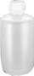
Gas Transfer and Dissolved Oxygen Probe
7 kPa Pressure sensor (optional)
200 kPa Pressure sensor
Accumulator
DO probe
N₂
Temperature probe
(optional)
S₂
Stir bar
Solenoid Valve
S₁
Needle Valve
1.5 mm ID x 5 cm restriction
Air Supply

Slide 2
Oxygen Probe
Signal Conditioning circuit turns A into a voltage
A
0.8 V Voltage source
Current meter
330 nanoamps typical at 37°C and 1 atmosphere in air.
Oxygen consumption: less than 10⁻⁷ grams of oxygen per hour (less than 0.1 µL of oxygen per hour) in air.
Oxygen permeable membrane
O’ring
KCl electrolyte
anode
cathode
What controls the current?

Slide 3
Dissolved Oxygen Probe: Theory
Applied 0.8 V reduces O₂ to H₂O at the cathode and keeps the O₂ concentration very low
The cell is separated from solution by a gas permeable membrane that allows O₂ to pass through
The rate at which oxygen diffuses through the gas permeable membrane is proportional to the difference in oxygen concentration across the membrane (proportional to the oxygen concentration in the solution)
Oxygen reduction produces a current that is measured by the meter

Slide 4
Dissolved Oxygen Probe: Calibration
Single point (linear) calibration at saturation
Saturation concentration
Temperature dependence
Atmospheric pressure dependence
Membrane temperature effect
Diffusion through membrane is a function of temperature
Linear calibration coefficient
Equation for calculating DO
mg/L
K
atm

Slide 5
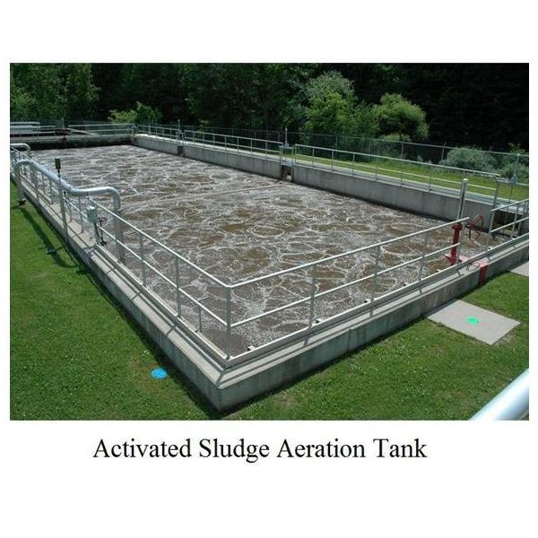
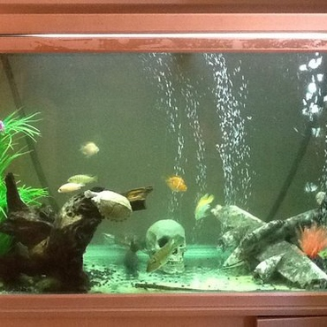
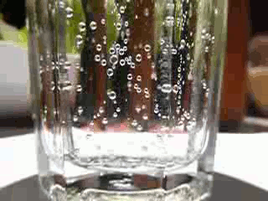
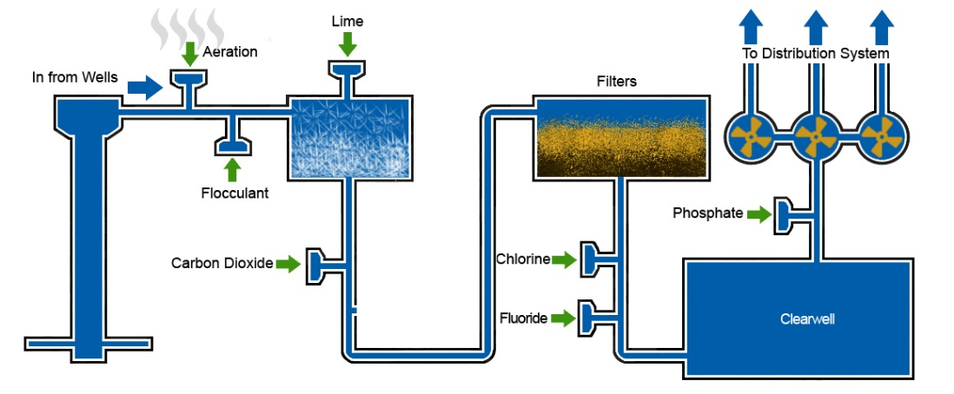
Aeration Processes

Slide 6
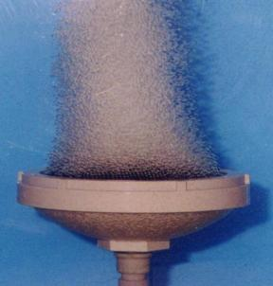
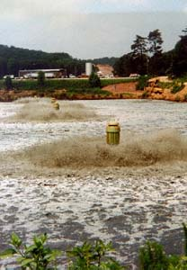
Aeration Methods
Diffused Aeration Systems: (compressed air pumped into aeration tanks)
Porous diffusers
Ceramic
Plastic membranes
Non-porous diffusers (hole in a pipe)
Mechanical Aeration Systems

Slide 7
What Controls Oxygen Transfer?
Deficit
_____________________
_____________________
_____________________
_____________________
______________________________________
______________________________________
What is C* at the bottom of a 10 m water tank?
How could you change residence time?
transfer coefficient
Bubble surface area
Bubble residence time
Turbulence
Bubble pressure (depth and surface tension)
overall volumetric oxygen transfer coefficient

Slide 8
What is ?
Overall volumetric gas transfer coefficient
v is for volumetric (it is based on the volume of the reactor rather than the more fundamental and illusive quantity of the interfacial area)
l is for the liquid phase. The liquid phase transfer is the slow step in this process (gas phase transfer is very rapid) and thus liquid phase resistance completely dominates the gas transfer
A first order reaction coefficient with units of 1/t

Slide 9
Aeration: Initial Oxygen Deficit, No BOD
C
D_{o} = 5 mg/L
C*
5 mg/L
Where is the best data for calculating ?
t
C* = oxygen concentration in equilibrium with atmosphere

Slide 10
Measuring the Transfer Coefficient
Specific for a particular reactor design/configuration and for a specific flow rate
We want to know how the transfer coefficient varies with flow rate (so we can estimate how much oxygen we are delivering)
integrate

Slide 11
Oxygen Transfer Efficiency (OTE)
Percentage of the mass of oxygen transferred into the water divided by the mass of oxygen supplied to the water
You will calculate OTE for your system
OTE will be less under wastewater conditions
Lower oxygen solubility (salts, organic matter)
Lower surface tension

Slide 12
Oxygen Transfer Efficiency: O2 dissolved / O2 delivered
How do we measure the rate that oxygen is dissolving?
V is reactor volume
But dC/dt varies with oxygen deficit
Our goal is to measure this in lab
After we have measured the transfer coefficient we can easily calculate the oxygen transfer rate
Compare with supplied O₂ flow rate

Slide 13
Preparation for Lab
Come ready to play
Ask lots of questions!
Make it your goal to understand as much of the system as you can!
You will be assembling the airflow control hardware and creating the rules for the states to control the process

Slide 14
ProCoDA
ProCoDA will control the air flow rate (how?)
ProCoDA combines 3 elements:
sensors (inputs from the real world)
set points (inputs from the plant operator and calculated values based on sensors and other set points)
logic (rules that govern how the plant should operate given the sensor data and set points)
Make it your goal to understand as much of the system as you can!

Slide 15
Air flow control system
7 kPa Pressure sensor (optional)
200 kPa Pressure sensor
Accumulator
DO probe
N₂
Temperature probe
(optional)
S₂
Stir bar
Solenoid Valve
S₁
Needle Valve
1.5 mm ID x 5 cm restriction
Air Supply
How could you know how much of the time to open S1 to deliver a target airflow?
Notes:
How could you learn how much air will flow through the restriction as a function of the supply and accumulator pressures?
How can you measure air flow rate into the accumulator?

Slide 16
Calibration
What happens if accumulator is empty, S2 is closed and S1 is opened?
P
t

Slide 17
After Calibration
What happens if accumulator is empty, S2 is closed and S1 is computer controlled to deliver a desired air flow in Mole/s?
P
t

Slide 18
Needle valve role?
What happens to steady state pressure in accumulator as needle valve is closed?
P
t

Slide 19
Aeration Analysis
Large data set
I am writing code to make this easier for you!
Plan how you will organize the analysis
How can you format the data so all of the data sets are addressed identically?
If you find the analysis repetitive, figure out how to program in python to do the repetitive tasks

Slide 20
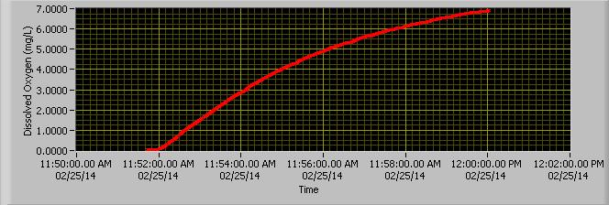
Data Hints
What does our model describe?
Reaeration!
Therefore need to find sections of data containing reaeration!
Discard the rest
Look for any errors in the data
How might you modify the experimental protocol to collect a better set of data?

Slide 21
An empirical model for the oxygen transfer coefficient?
Why are there diminishing returns at high flow rates?
What will happen as the flow rate continues to increase?
How would you draw a curve through the data?
What type of function might produce this behavior?
What is the transfer coefficient when the air flow rate is zero?

